Slide 1

Decision Analytic Fundamental final project
12/18/20

Slide 2
Industry question: Which CRISPR Company is in the best shape?

Slide 3

Agenda
Background on CRISPR
Industry overview
Top companies in the space
Comparison of top companies
Explanation of "best" CRIPSPR Company to invest in

Slide 4
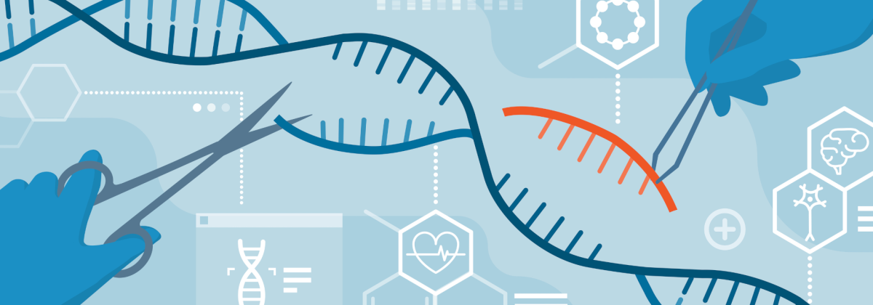
Background: Clustered regularly interspaced palindromic repeat
CRISPR is a bacteria immune system that has can be used in eukaryotic (animal and plant) cells to edit their DNA (rewriting DNA, "rewire" gene networks)
Applications span industries (health, agriculture, biotech, etc.)

Slide 5
Overview: CRISPR Industry as a whole
2018
$75B in 2018
2027
$218B by 2027

Slide 6
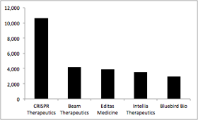
Overview: Top Companies in the space by market cap

Slide 7
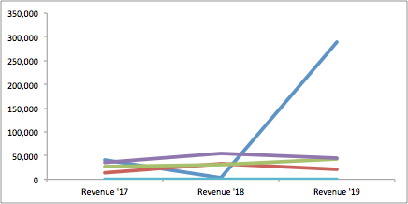
Analysis: Comparison of financials (Revenue)
CRISPR Therapeutics
Bluebird Bio
Intellia
Editas
Beam

Slide 8
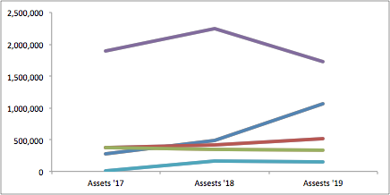
Analysis: Comparison of financials (Assests)
Bluebird Bio
CRISPR Therapeutics
Editas
Intellia
Beam

Slide 9
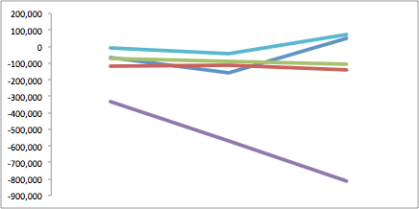
Analysis: Comparison of financials (Operating Income)
Beam
CRISPR Therapeutics
Intellia
Editas
Bluebird Bio

Slide 10
Industry question: Which CRISPR Company is in the best shape? : Conclusions: CRISPR Therapeutics highest revenue, growing assets....next steps qualitative analysis

